Slide 1



AI Powered Deepfake Detection for Preventing Misinformation
TEAM ID : IN25-196
Project by:
SUSMITHA P
GAYATRI R

Slide 2
ABSTRACT
Deepfake technology undermines information integrity by producing highly realistic fake media. In this paper, we propose an AI-based detection mechanism leveraging in-depth learning, forensic analysis, and blockchain verification to detect and thwart the creation and spread of deepfake videos on social media and news platforms.
This proposed solution improves accuracy, ensures content authenticity, and alerts in real-time to reduce the false information. Through embedding AI-powered detection systems, this method enhances digital confidence, contributing an effort to fight against the dispersion of altered data and protecting accurate information flow.

Slide 3
PROBLEM
Misinformation is spreading faster than ever, and hyper-realistic fake videos, images, and audio make it increasingly difficult to distinguish truth from fiction. Imagine a world where public figures are made to say things they never did, false news spreads unchecked, and identities are stolen effortlessly.
As this technology advances, detecting these manipulations becomes more challenging, threatening trust, security, and credibility across social media and news platforms. To combat this, we need advanced detection solutions that can identify and eliminate deceptive content, protecting individuals and ensuring the integrity of digital information.

Slide 4
PROPOSED SOLUTION
To combat deepfake misinformation, we propose an AI-powered detection system with the following features:
AI-Based Analysis – Uses advanced algorithms to examine videos, images, and audio for signs of manipulation.
Facial and Voice Detection – Identifies unnatural facial expressions, lip-sync issues, and voice distortions.
Forensic Analysis – Detects inconsistencies in lighting, pixel structures, and motion patterns.

Slide 5
PROPOSED SOLUTION
Blockchain Verification – Tracks and verifies content sources to ensure authenticity.
Real-Time Monitoring – Flags and alerts platforms about suspected deepfake content.
Integration with Social Media & News Platforms – Helps in automatic detection and removal of fake content.

Slide 6
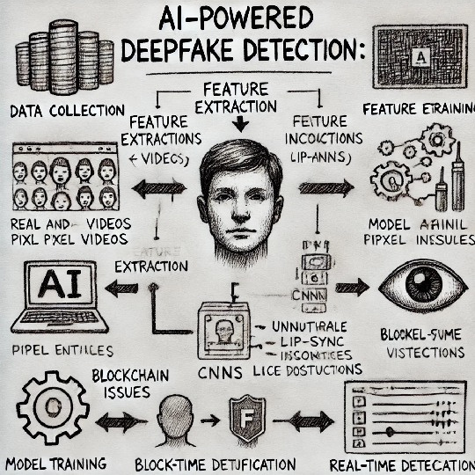
Architecture Diagram:

Slide 7
METHODOLOGY
Data Collection – Gather a dataset of real and deepfake videos, images, and audio from reliable sources for training and testing.
Model Training – Use AI models (CNNs, RNNs) for deepfake detection.
Feature Extraction – Analyze facial expressions, pixel inconsistencies, and voice distortion.
Forensic Analysis – Detect unnatural lighting, lip-sync issues, and metadata inconsistencies.

Slide 8

Blockchain Verification – Ensure content authenticity through secure tracking.
Real-Time Detection – Integrate the system into social media and news platforms
Testing & Evaluation – Measure accuracy, precision, and false positive rates.

Slide 9
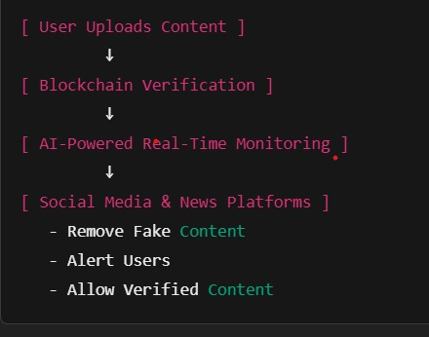
PROTOTYPE:

Slide 10
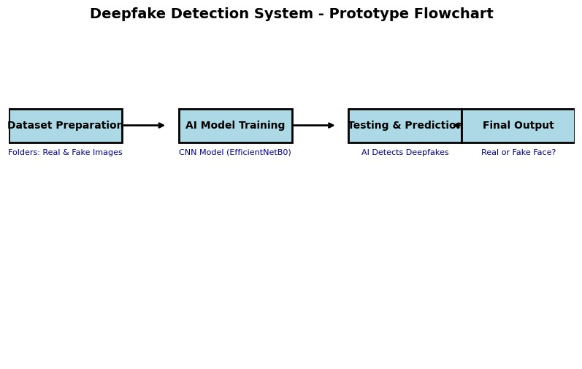
PROTOTYPE:

Slide 11
TECHNOLOGY STACK
1. AI & Machine Learning
Programming Language: Python
Frameworks & Libraries: TensorFlow, PyTorch, OpenCV, dlib, DeepFace
Pretrained Models: FaceForensics++, XceptionNet, DeepSpeech
2. Forensic Analysis
Tools: FFmpeg, Error Level Analysis (ELA), Spatio-Temporal Analysis
Libraries: Wavelet Transform, Image Forensics

Slide 12
3. Blockchain for Verification
Blockchain Platforms: Ethereum (Solidity), Hyperledger Fabric
Decentralized Storage: IPFS
4. Real-Time Detection & Integration
Backend Development: Flask, FastAPI, Node.js
Frontend : React.js, D3.js
Message Queuing: RabbitMQ, Apache Kafka

Slide 13
5. Cloud & Deployment
Cloud Services: AWS, Google Cloud, Azure
Containerization & Orchestration: Docker, Kubernetes
6. Social Media & News Platform Integration
APIs: Facebook Graph API, Twitter API, YouTube Data API
Web Scraping: Scrapy, BeautifulSoup, Selenium
7. Testing & Evaluation
Metrics: Precision, Recall, F1-score, Confusion Matrix, ROC Curve

Slide 14
ADVANTAGE
Enhanced Misinformation Control – Prevents the spread of false information by identifying deepfake content in real-time.
Improved Digital Trust – Helps restore credibility to social media and news platforms by ensuring content authenticity.
Automated and Scalable – AI-based detection can analyze vast amounts of data faster than manual verification.

Slide 15
Real-Time Alerts – Provides immediate warnings to prevent the circulation of deepfake content.
Blockchain Integration – Ensures secure and verifiable content tracking, reducing tampering risks.
Comprehensive Detection – Uses multiple methods like facial recognition, voice analysis, and forensic analysis for higher accuracy.
Seamless Integration – Can be integrated into existing platforms for automated detection and removal.

Slide 16
DISADVANTAGE
False Positives & Negatives – AI may incorrectly classify real content as deepfake (false positives) or miss detecting some deepfakes (false negatives).
Computationally Expensive – Requires high processing power, storage, and cloud resources for large-scale detection.
Evolving Deepfake Technology – Deepfake generation methods are continuously improving, making detection more challenging.

Slide 17
Privacy Concerns – AI-based detection requires analyzing user-generated content, which raises ethical and privacy concerns.
Dependence on Training Data – Accuracy relies on the quality and diversity of training datasets, which may not cover all deepfake variations.
Blockchain Overhead – Using blockchain for verification increases latency and costs due to transaction processing.
Limited Legal Frameworks – There are no standardized global regulations for deepfake detection and removal, leading to potential legal and ethical dilemmas.

Slide 18
CONCLUSION
Deepfakes pose a growing threat to digital trust and misinformation. Our AI-driven detection system integrates machine learning, forensic analysis, and blockchain verification to identify and prevent fake content in real-time. While challenges like evolving deepfake techniques and computational costs exist, this solution strengthens content authenticity and enhances security across social media and news platforms.

Slide 19
REFERENCE
﻿Link : https://www.researchgate.net/publication/376329868_Exploding_AI-Generated_Deepfakes_and_Misinformation_A_Threat_to_Global_Concern_in_the_21st_Century

Slide 20
Thank You

